Slide 1

Project Title: Leader-Based Community Detection Algorithm in Attributed Networks
Team Number:DB4
ROLL NO. | NAME
AM.EN.U4CSE20339 | Krishnpriya Dinesan
AM.EN.U4CSE20366 | Sreesankar S
AM.EN.U4CSE20321 | Devesh Kumar V V
AM.EN.U4CSE20152 | Pranav B Nair
Amrita School of Computing | Amrita Vishwa Vidyapeetham | Amritapuri

Slide 2
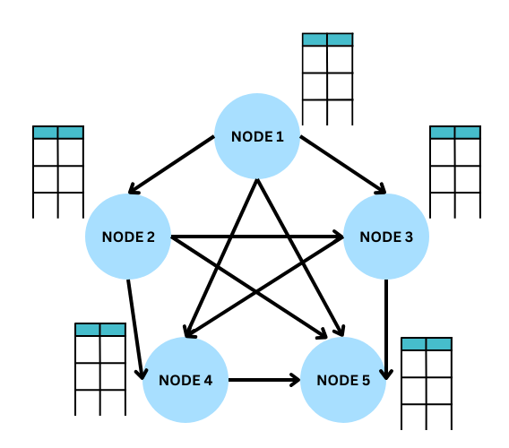
Introduction
This project develops a Leader-Based Community Detection Algorithm for attributed networks, aiming to improve community detection accuracy by leveraging both node attributes and network structure. Motivated by the need for more effective methods in complex networks, the algorithm addresses the challenge of integrating topological and attribute information. Challenges include optimizing accuracy and efficiency in large-scale networks.
Attributed networks combine node attributes with network structure. Community detection involves identifying cohesive groups of nodes within a network, which is valuable for understanding complex
relationships and has applications in various fields.

Slide 3
Problem to be addressed:
The project aims to tackle the complex task of community detection in attributed networks by introducing a Leader-Based Community Detection Algorithm, which identifies groups of nodes with strong interconnections while considering associated attributes for more insightful results.
Relevance of this project:
Crucial in fields of social network analysis, recommendation systems, and understanding complex relationships.
Traditional community detection methods frequently miss out the valuable attribute information. To solve that we are proposing a LBCD method for effective outcomes.
Accurate and meaningful community detection results in attributed networks.

Slide 4



Motivation
Real life motivation scenario:
Social Media Analysis:
Influencer Identification
Content Recommendation
Epidemiology and Disease Spread:
Identifying Super-Spreaders
Vaccination Campaigns
Marketing and Customer Segmentation:
Customer Segmentation
Identifying Brand Advocates

Slide 5
Background Study/Related Work
Title &year | Problem | Contributions | Limitations | Open problems/Future work
Leader-aware Community Detection in Complex Networks Springer [2019] | Study the problem of community detection in complex networks and propose a novel method, which can detect community structures automatically as well as identify community leaders. | Leader-aware community detection algorithm that incorporates the concept of leadership to improve the accuracy of community detection. | Assumes a static network, where the connections between nodes remain constant throughout the analysis. The algorithm may not perform optimally on very large networks | Investigating the algorithm’s performance on dynamic networks, exploring the impact of different leadership score definitions, and enhancing the algorithm’s scalability for large-scale networks.
Leader Similarity Based Community Detection Approach for Social Networks IEEE [2020] | Addresses the challenge of simultaneous community detection and leader selection in social networks without prior knowledge of community sizes and numbers. | Proposes the "Leader Similarity Based Community Detection (LSBCD)" algorithm | Algorithm's focus is on non-overlapping communities Another limitation is on the applicability to extremely large and dynamic networks(real-time social media platforms) | Extending LSBCD for overlapping communities in social networks to enhance real-world applicability. Testing on dynamic social media platforms to assess its performance. Scalability for big data scenarios.

Slide 6
Title &year | Problem | Contributions | Limitations | Open problems/Future work
Leader-Based Community Detection Algorithm in Attributed Networks IEEE [2021] | Need for an improved community detection method that incorporates both topological and attribute information to maintain the integrity of information in complex networks. | Introduces TALB, a leader-based method that integrates topological and attribute information. A dependency tree is formed by combining attribute similarity matrices with network topology. | Faces efficiency challenges in large, dense networks. Incorporating topological and attribute information may increase computational overhead. Addressing this requires efficient algorithms and extensive evaluations for real-world applicability. | Parallelization, distributed computing, or sampling approaches to improve scalability. Also investigate the robustness of the TALB method under different perturbations, such as node removal, edge addition, or changes in attribute data.
Community Detection in Attributed Networks Using Graph Wavelets. IEEE [2022] | Graph signal processing-based approach to community detection in attributed networks. | Spectral graph wavelets to filter the attributes and constructs a new network from the graph filtered attributes across different scales. | Computational complexity, sensitivity to graph structure, and challenges with continuous attributes and attribute dependencies. | Other kernel functions and the extension of this framework to detect multi-scale community structure.

Slide 7
Persisting Challenges
Challenges identified
Effective leader selection in the network.
Scalability and efficiency, particularly in large-scale networks.
Incorporating topological information into the algorithm.

Slide 8
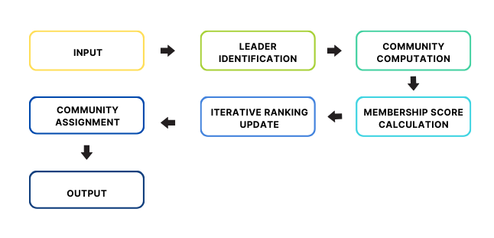
High Level Design

Slide 9
Project Contributions
The project contributes in the following ways:
Improved Community Detection: The primary objective is to develop an algorithm that bridges the gap between topological and attribute information for more accurate community detection.
Enhancements: Addressing the challenge of scalability in large-scale networks to ensure the algorithm's applicability to real-world scenarios.
What are the objectives?
The objectives of the project include developing and implementing the Leader-Based Community Detection Algorithm, optimizing leader selection, and evaluating the algorithm's performance in real-world attributed networks.

Slide 10
What are the outcomes?
The expected outcomes are an efficient and effective community detection algorithm that leverages both network topology and attributes, along with insights into its scalability and performance.
State the assumptions if any.
The assumptions for the project include that the network is undirected and unweighted, attribute information is categorical, and the dataset is available in a public repository.

Slide 11
Algorithms
Two algorithms to be implemented in Project Phase I:
Leader Selection Algorithm: This algorithm will focus on identifying influential leaders within the network, considering both topological characteristics and attribute information. It should effectively select nodes that can guide the community detection process.
Attribute-Based Community Detection Algorithm: This algorithm will form the core of the project, aiming to detect communities by combining attribute similarity matrices with network topology. It should efficiently identify cohesive and meaningful communities within the attributed network.

Slide 12
LEADER SELECTION ALGORITHM:
Degree Centrality
Betweenness Centrality
Closeness Centrality
Eigenvector Centrality
Out of these, Eigenvector Centrality is a good choice for our project as it is better in:
Consideration of Quality and Quantity
Identifying Influential Nodes
Integration of Network Structure and Node Attributes
Robustness

Slide 13
Community Computation:
K-means: K-means is a centroid-based clustering algorithm, where we calculate the distance between each data point and a centroid to assign it to a cluster.
Louvain Method: This method optimizes a modularity score to find communities in a network. It can be extended to attributed graphs by considering node attributes in the modularity calculation.
Membership Score Calculation:
Node Similarity Measures: Calculate node similarity scores based on both network structure and attributes. For example, Jaccard similarity, cosine similarity, or Euclidean distance can be used to measure similarity between nodes.
Louvain Method: This method optimizes a modularity score to find communities in a network. It can be extended to attributed graphs by considering node attributes in the modularity calculation.

Slide 14
Iterative Ranking Update:
Used to refine or improve the rankings, scores, or assignments in a way that better reflects the underlying characteristics or objectives of the algorithm.
Community Assignment:
Assign nodes to communities based on their highest membership score while considering the specified threshold.

Slide 15
References
[1] A. Kesarwani, A. Singh, K. Gaurav and A. K. Shankhwar, "Leader Similarity Based Community Detection Approach for Social Networks," 2020 IEEE International Conference for Innovation in Technology (INOCON), Bangluru, India, 2020, pp. 1-6, doi: 10.1109/INOCO
[2] D. -D. Lu, "Leader-Based Community Detection Algorithm in Attributed Networks," in IEEE Access, vol. 9, pp. 119666-119674, 2021, doi: 10.1109/ACCESS.2021.3109124.
[3] Sun, Heli & Du, Hongxia & Huang, Jianbin & Li, Yang & Sun, Zhongbin & He, Liang & Jia, Xiaolin & Zhao, Zhongmeng. (2020). Leader-aware community detection in complex networks. Knowledge and Information Systems. 62. 10.1007/s10115-019-01362-1.
[4] Ahajjam, Sara & Mohamed, El Haddad & Hassan, Badir. (2018). A new scalable leader-community detection approach for community detection in social networks. Social Networks. 54. 41-49. 10.1016/j.socnet.2017.11.004.
[5] Yakoubi, Zied & Kanawati, Rushed. (2014). LICOD: A Leader-driven algorithm for community detection in complex networks. Vietnam Journal of Computer Science. 1. 241-256. 10.1007/s40595-014-0025-6.
[6] Shah, Devavrat & Zaman, Tauhid. (2010). Community Detection in Networks: The Leader-Follower Algorithm.

Slide 16
Thank You!

